Slide 1

POC Summary
Example POC Summary based on recruiting Exercise

Slide 2
Current Status vs. Target Situation
Current Situation
No clear picture overview environment
DB Performance
No “single Point of Truth”
No flexible reporting
Monitoring the System
Missing Exception Handling
Missing Alerting
POC outcome
Monitoring different System
Using 2 MacBook for Demo
Monitoring a MySql DB
Creating different Dashboards
Flexible customizing of Dashboards
Monitoring System (with a sample Metric)
Showing power of Alerts with Exception handling (e.g. Weekend, Night)

Slide 3
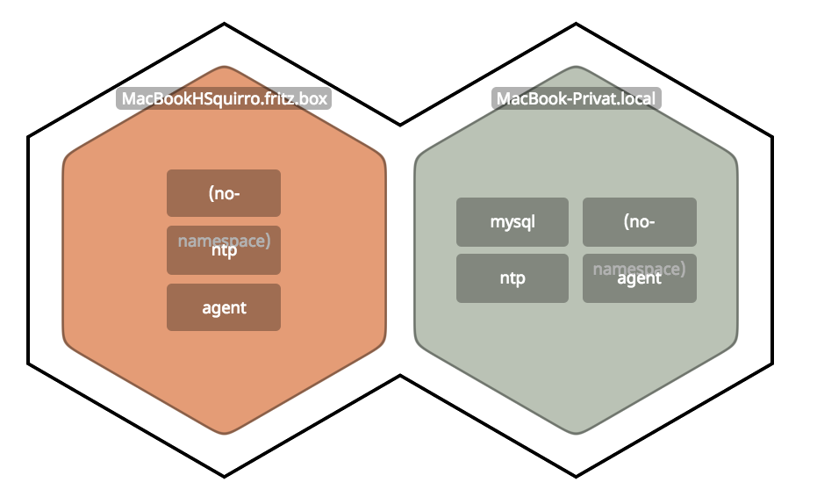
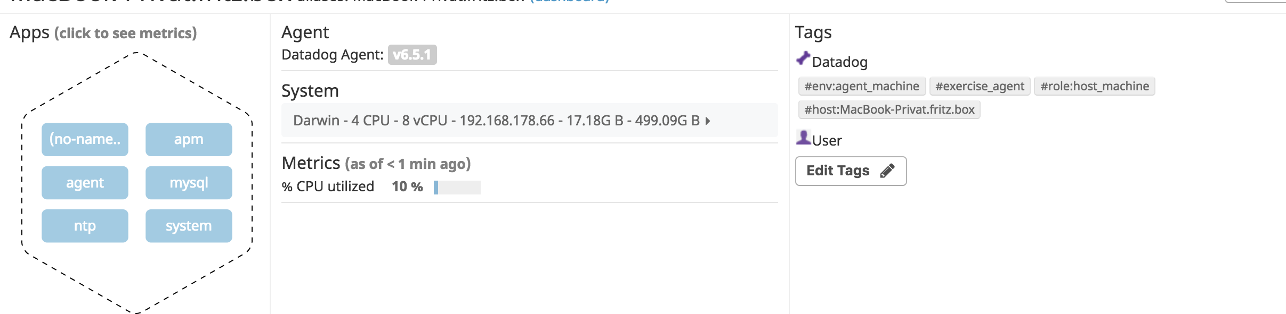
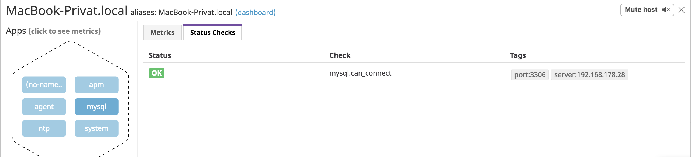
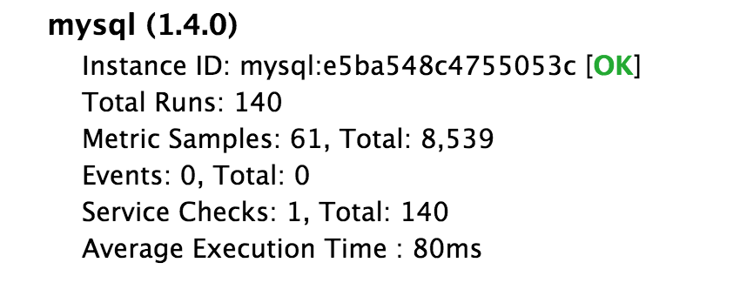
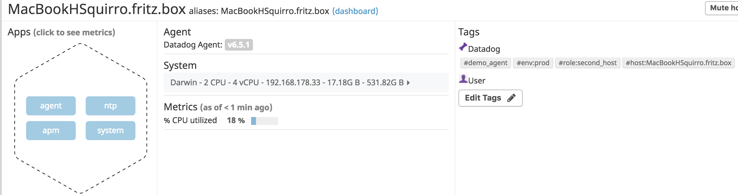
Setup - Environment
Environment
2 Macbook Pro with individual Agents
MacBook Pro (13-inch, 2017) - 2,3 GHz Intel Core i5
MacBook Pro (Retina 15', Mitte 2014) - 2,5GHz Intel Core i7
MySQL Database on a NAS
Creating global User to access
Configuration of Agent to access DB
Overview – Connected Agents
MySql DB
Status Overview
Instance Information
Status for both connected Agents

Slide 4
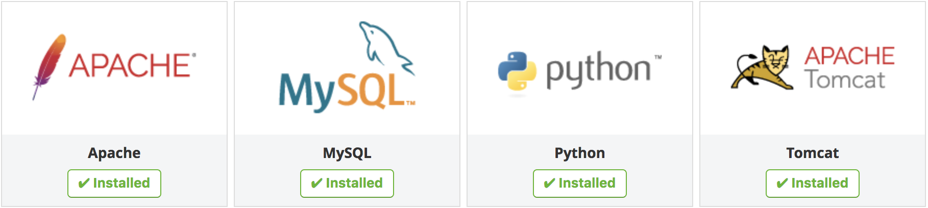
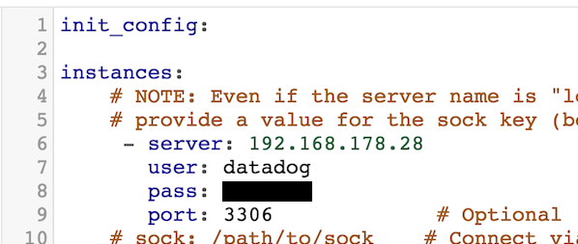

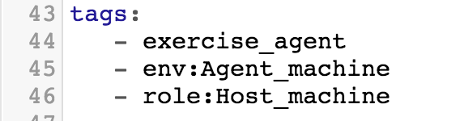
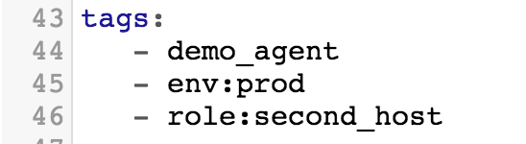
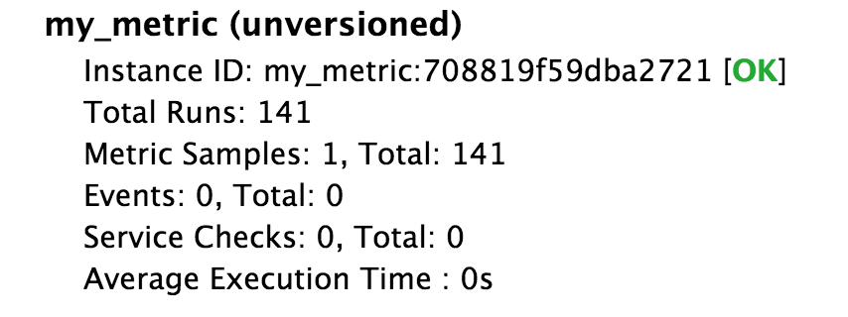
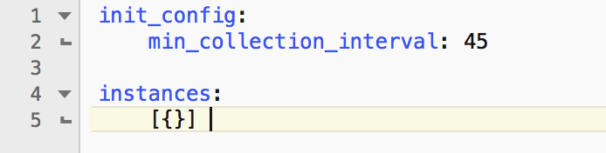
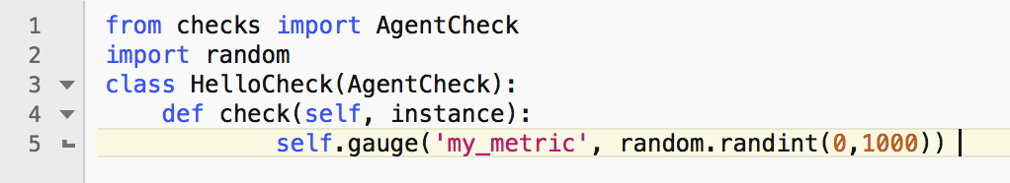
Prerequisites – Configure the environment
Setup Integrations
Connecting to MySql
Configuration
Security
Creating User for global access
Setting Permission for accessing DB remote
Configure Agent
Tags for each Agent
Creating random Metric
Tags: Agent 1
Tags: Agent 2
Metric Script
Metric Monitor

Slide 5
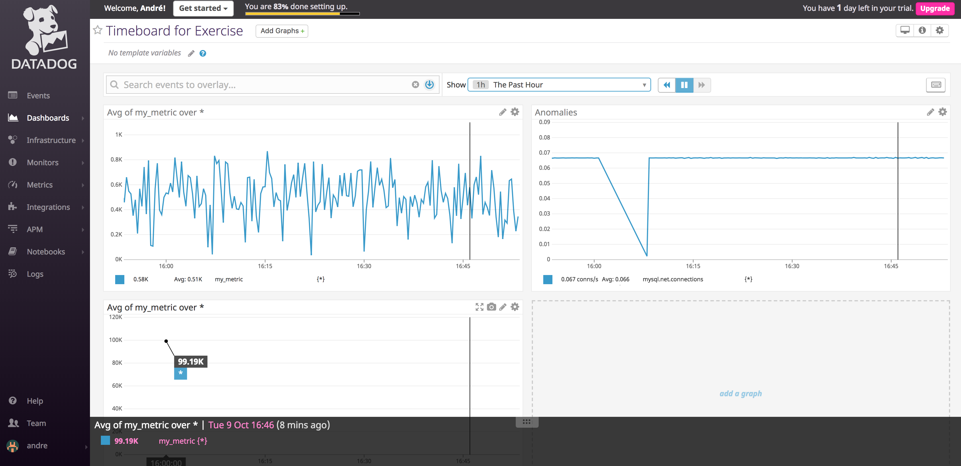
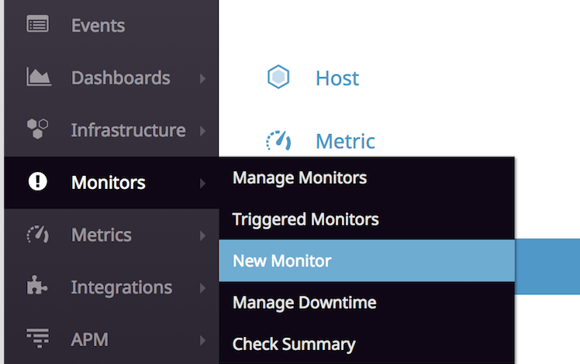
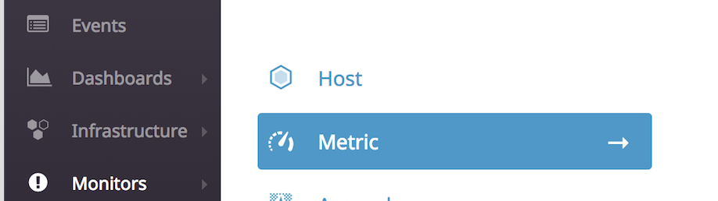
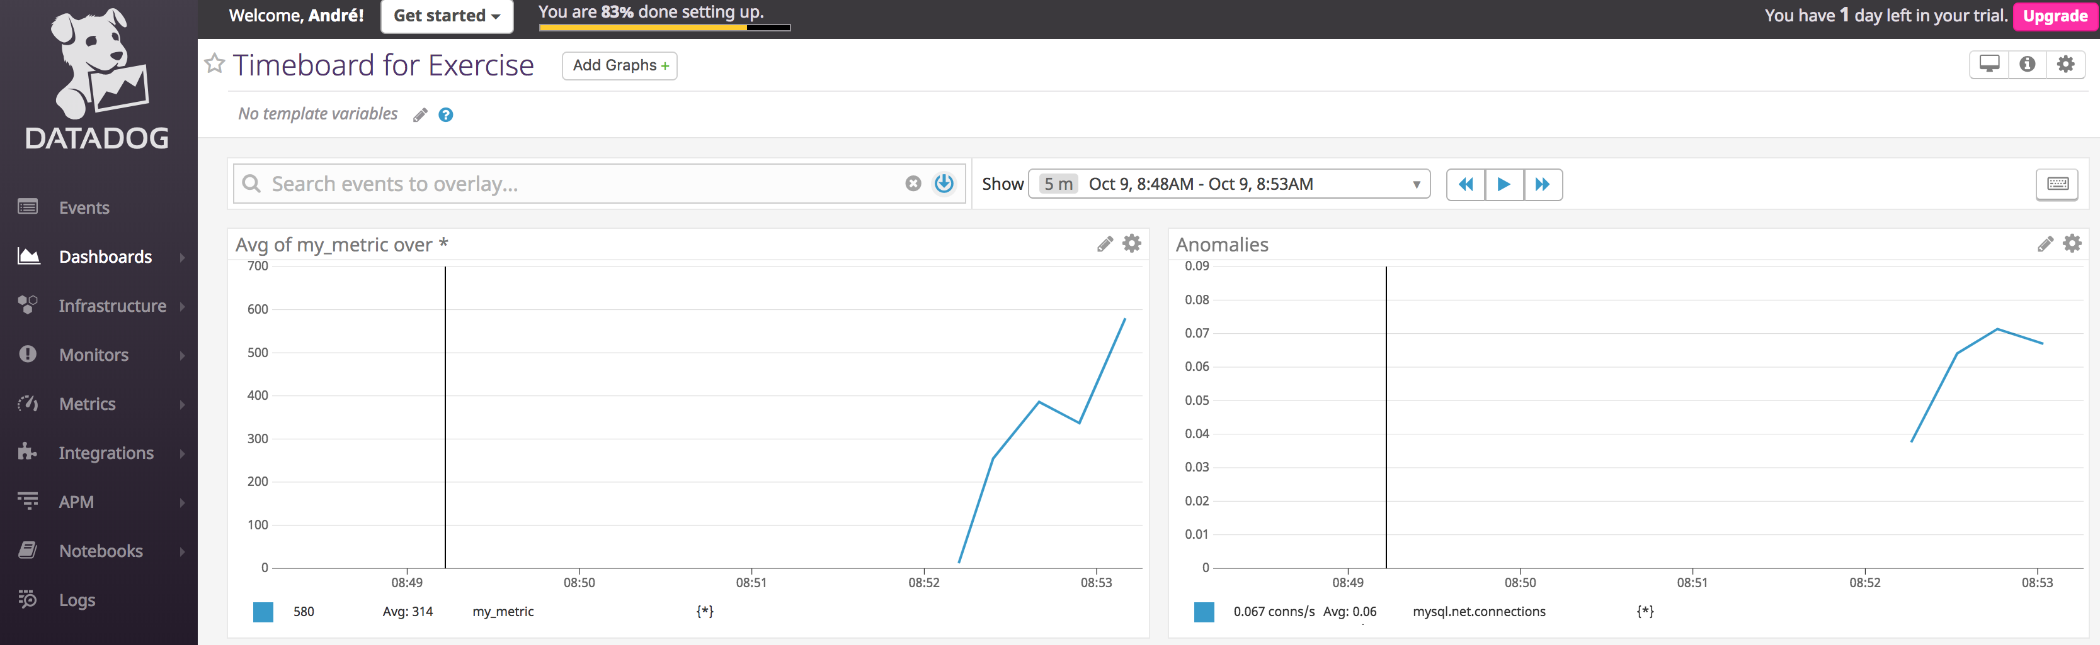
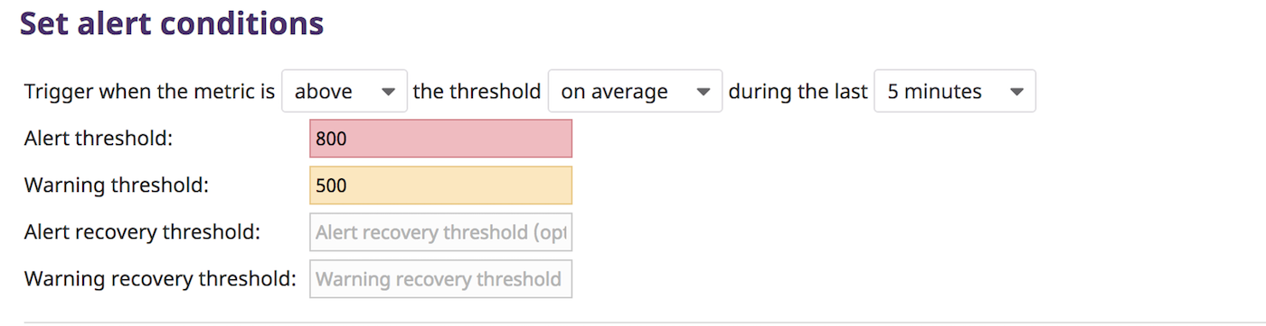

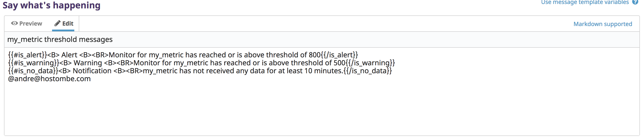
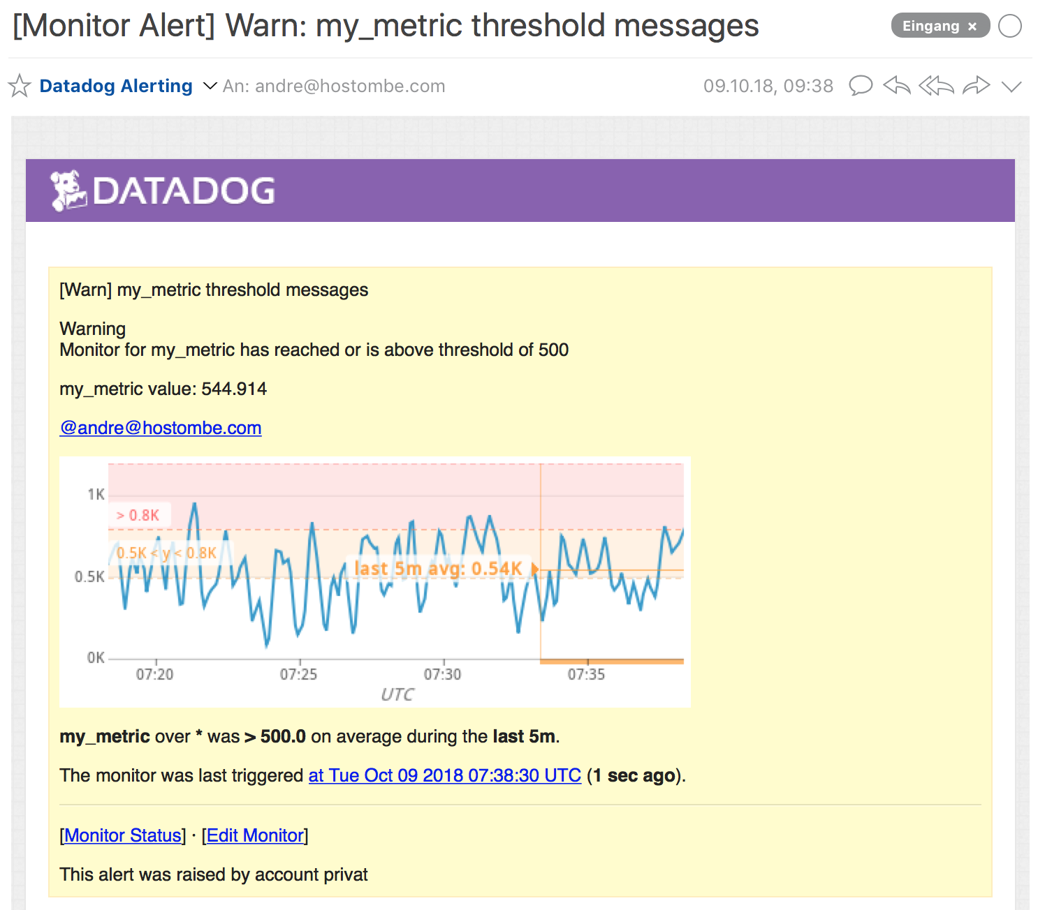
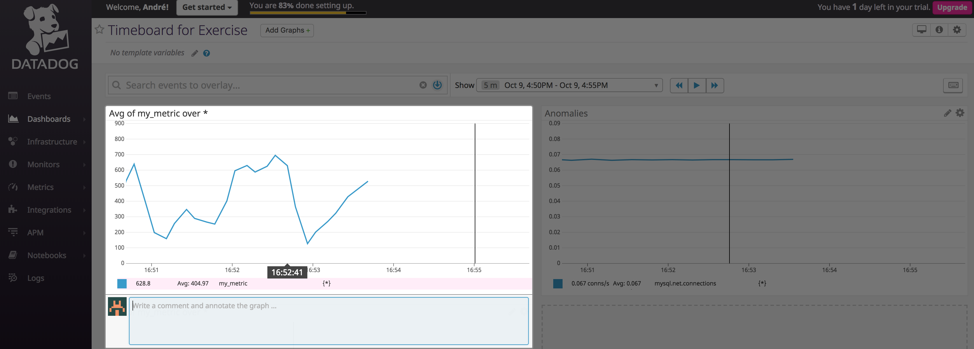
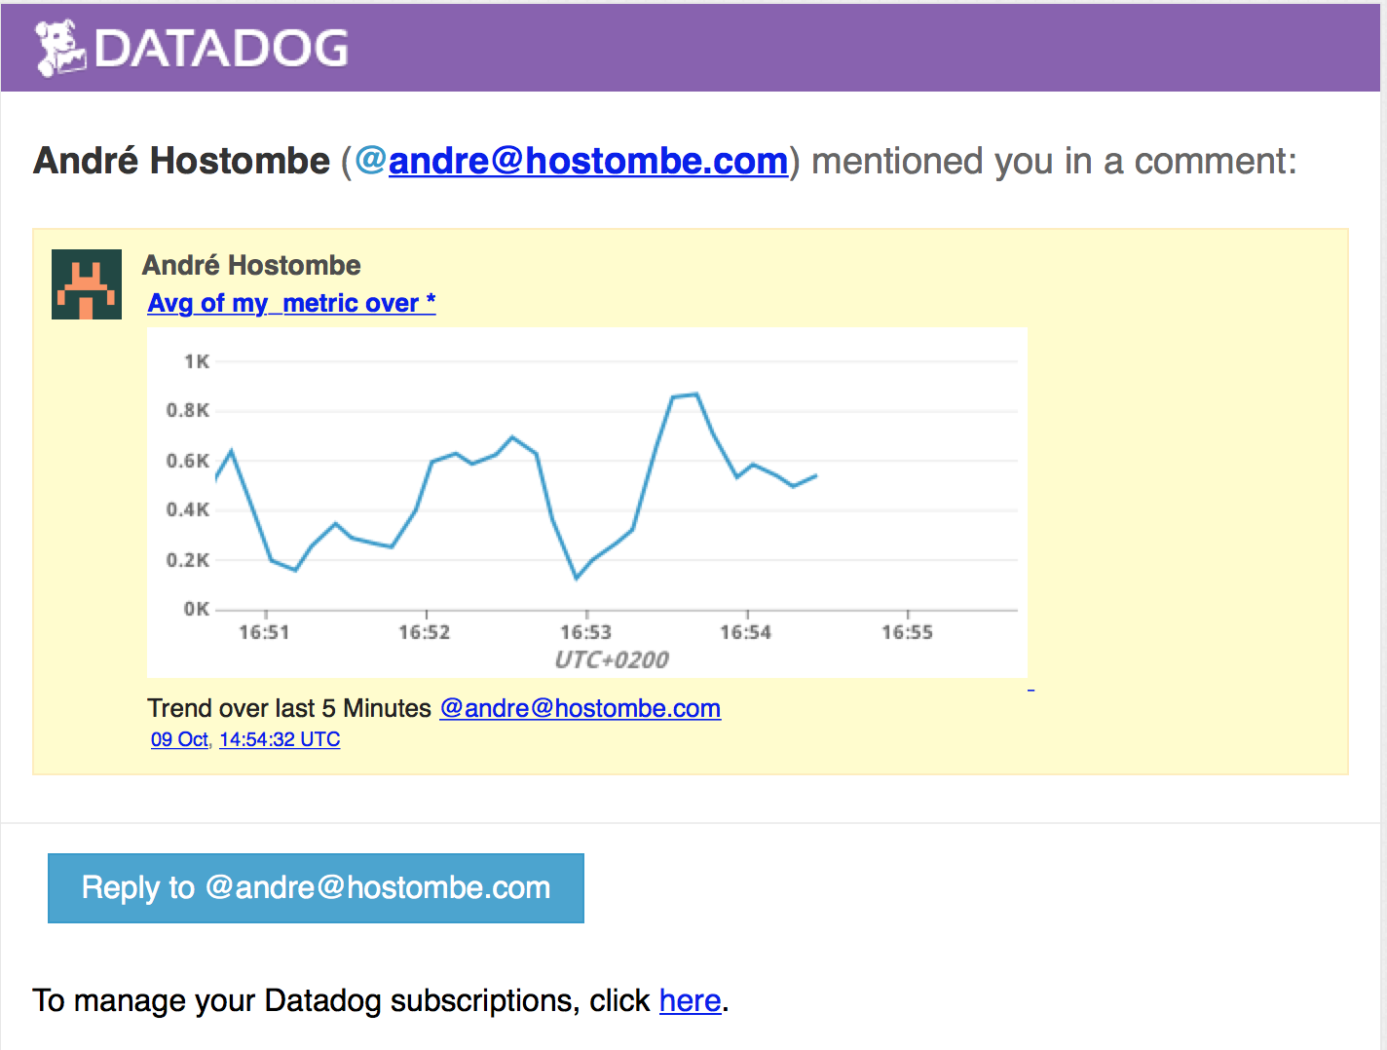
Visualizing – General & Alerting
Timeboard
Dashboard with different Metric
Customizing View
Selection and Export
Monitoring
Creating Monitor on random Metric
Definition of Threasholds
Sending dynamic Mails
Monitor Definition
Metric Monitor
Monitor Condition
Definition of Notication
Full Dashboard
Selected Timeframe
Dynamic Monitor Message
Aut. generated Monitor Mail
Selected Timeline
Exported Timeline

Slide 6
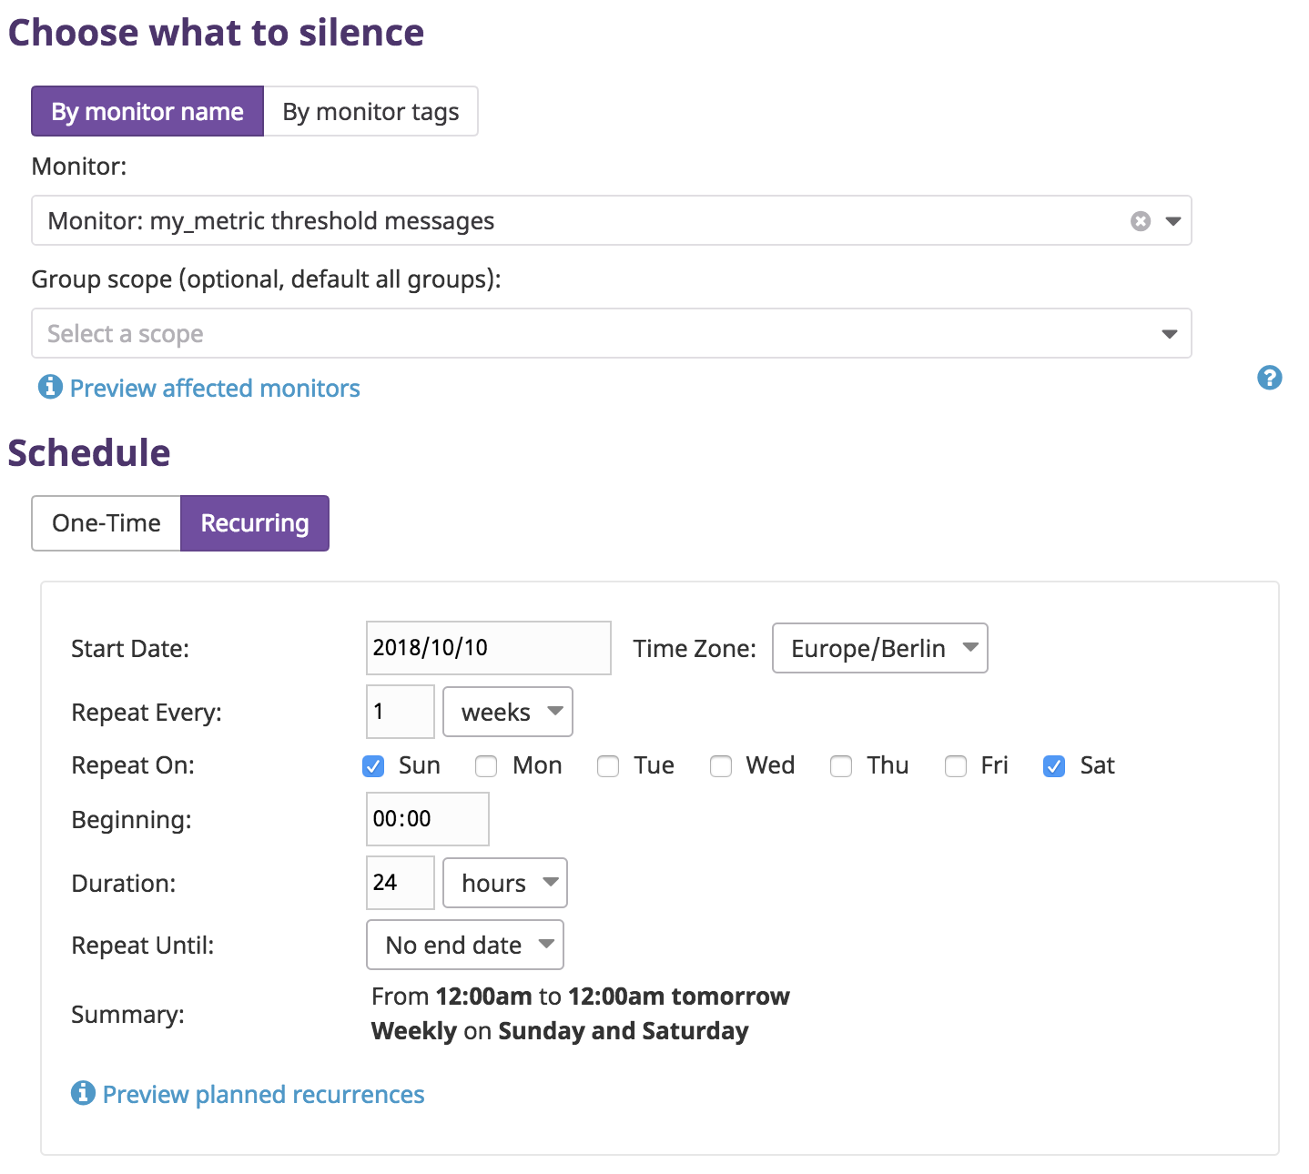
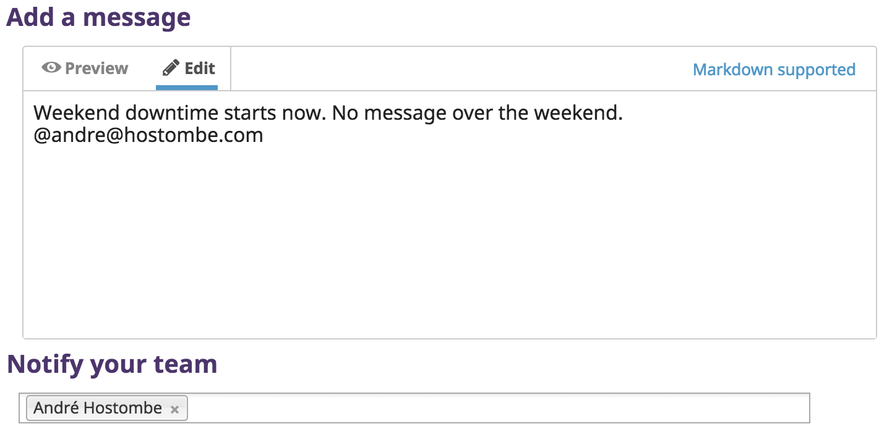
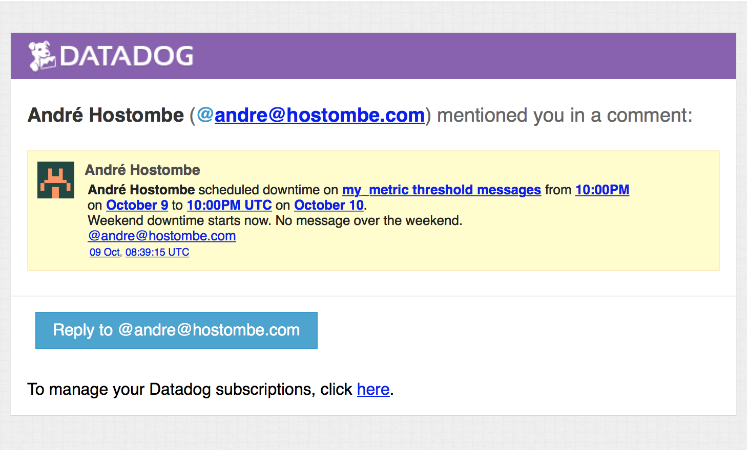
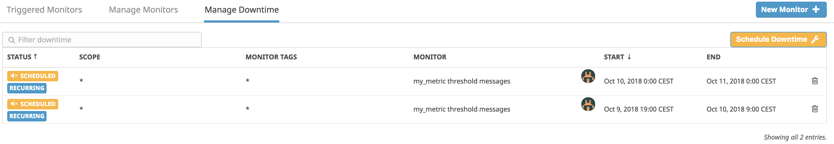
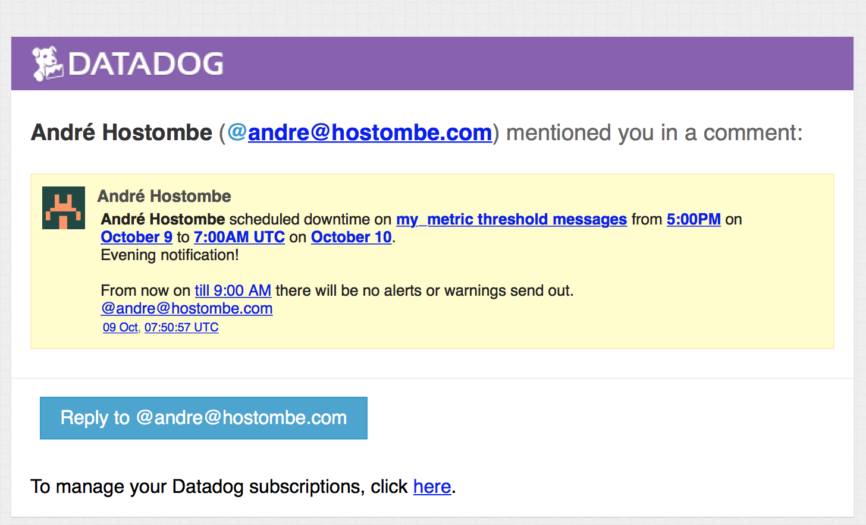
Visualizing – Alerting part 2
Monitoring – “Silence”
Setting up Downtimes for
Weekend
Night (19.00 – 9.00)
Information Message
Outcome Mail
Overview Downtime Schedules
Downtime Message (e.g. Weekend)
Def. Downtime Schedules
Overview Downtime Schedules
Downtime Mail
Weekend
Night / Evening

Slide 7
Conclusion
Conclusion Points
Datadog have met all requirements that where addressed for the POC (see list on the right side).
Based on the requirements Datadog have shown that the solution could help with the following topics:
Getting a better overview and insight over the current System environment.
Identify and solve bottlenecks
Helps to scale
For growing user number
Changing data size
Growing Applications
POC outcome
Monitoring different System
Using 2 MacBook for Demo
Monitoring a MySql DB
Creating different Dashboards
Flexible customizing of Dashboards
Monitoring System (with a sample Metric)
Showing power of Alerts with Exception handling (e.g. Weekend, Night)

Slide 8
André Hostombe
Senior Sales Engineer
andre@hostombe.com
+49 157 84584585

